Slide 1

Tennis Data
Analytics
SportRadar Event Explorer: An End-to-End Data Pipeline for Tennis Competition Insights
Presented By
Karan Vasani
Dakshata Sadekar
Anjali Mishra
Sakshi Shinde

Slide 2
01
Project Overview
Bridging the gap between raw data and actionable sports insights

Slide 3

THE CHALLENGE & SOLUTION
Problem Statement
The Solution
Sportradar API provides high-fidelity tennis data, but in deeply nested JSON formats. Analyzing historical trends, player rankings, and venue locations directly from raw responses is inefficient and non-scalable for sports analysts.
An automated ETL pipeline that extracts JSON data, flattens complex structures, and stores them in a structured SQL relational database, coupled with a Streamlit dashboard for real-time visualization.

Slide 4






TECHNOLOGY STACK
Python
SQL
Streamlit
Used for API extraction, data cleaning, and processing using Pandas.
Relational storage for structured data with complex analytical querying.
Front-end web framework for building interactive data dashboards.

Slide 5
DATA PIPELINE ARCHITECTURE
Extraction
Transformation
Loading
Visualization
Fetching real-time data from Sportradar API endpoints.
Parsing nested JSON into flattened tabular structures.
Migrating cleaned data into relational SQL tables.
Rendering insights via Streamlit Interactive UI.

Slide 6
RELATIONAL DATABASE SCHEMA
Table Name | Description | Key Metrics Tracked
Competitors | Player Profiles | Names, Nationality, Gender
Rankings | Weekly Movements | Points, Rank Stability, Movement
Competitions | Tournament Metadata | Category, Type (ITF, ATP, etc.)
Venues | Geographic Data | Country, Complex Names, Courts

Slide 7
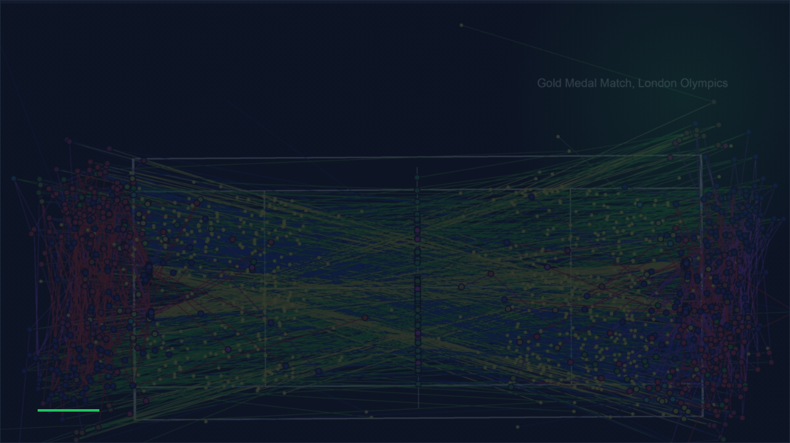
02
Analytical Deep Dive
Uncovering performance trends and tournament structures through SQL

Slide 8
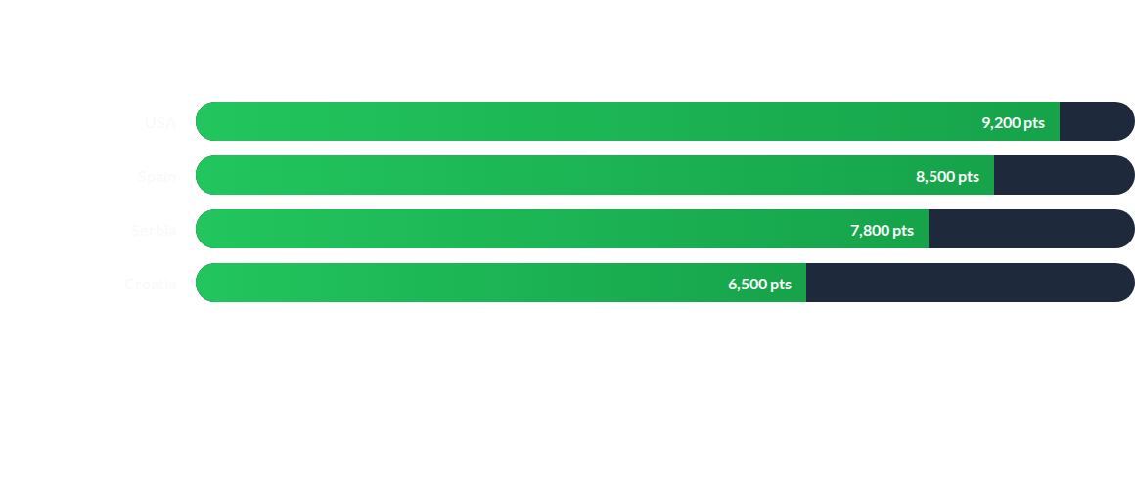
POINTS DISTRIBUTION BY COUNTRY
*Sample aggregated points from the rankings table indicating national dominance in specific tournament tiers.

Slide 9
IMPACT BY THE NUMBERS
100%
Data Pipeline Efficiency
The project successfully transforms complex JSON responses into a 6-table relational schema with zero manual intervention, allowing for instant SQL querying on player performance and tournament venues.
Automated Workflow

Slide 10

DASHBOARD UX
Interactive Exploration
The Streamlit application provides filters for competition levels, player search, and venue mapping.
It bridges the gap between raw backend SQL data and the end-user, enabling sports enthusiasts to visualize rank stability and country-wise performance trends effortlessly.

Slide 11
CONCLUSION & FUTURE SCOPE
Automated Scalability: Converted raw API responses into a searchable, relational database.
Historical Trends: Enabled analysis of rank stability and movement over multiple cycles.
Predictive Analytics: Future scope includes integrating ML models for match outcome predictions.
Live Mapping: Planning to add real-time GIS mapping for active tournament complexes.

Slide 12

Questions?
Thank you for your time!
Project: Tennis_Data_Analytics
GitHub: anjali-mishra012

Slide 13


IMAGE SOURCES
https://elements-resized.envatousercontent.com/elements-video-cover-images/af107d0c-c891-4180-8e42-eabf1cdbeb0a/video_preview/video_preview_0000.jpg?w=500&cf_fit=cover&q=85&format=auto&s=dccb8260eff14adf84ebe8778ef07ebbb42d662c66d6d51bc84973e4c881b1ff
Source: elements.envato.com
https://i.natgeofe.com/n/672fa47f-8c6a-486a-9916-9fadb4de9e50/olympic-medal-match-data-clean.jpg
Source: www.nationalgeographic.com

